Slide 1

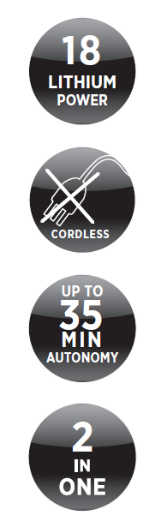
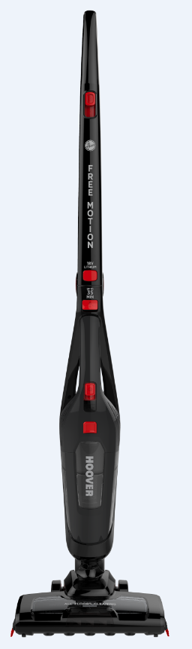
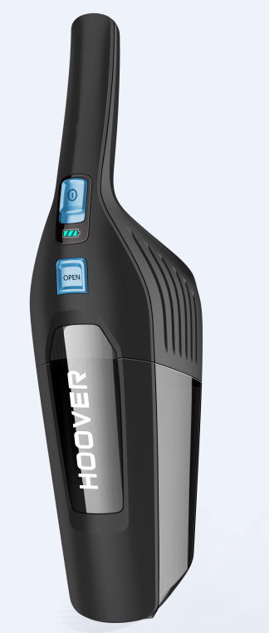
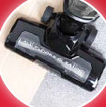
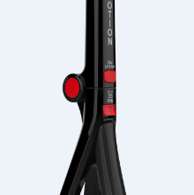
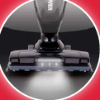
FREEMOTION 2in1
FM18LI 011
LUXOR BLACK /
RACE RED
Cordless stick and detachable handheld: 2 products in 1
18 volt Lithium Ion battery
Up to 35 minutes of autonomy
Cyclean bagless technology
Power regulation
Vertical parking position
Motorised nozzle
All surfaces cleaning
Led lights on the nozzle
Lightweight and flexible
Foldable handle
Carry handle
Washable filter
Detachable handheld
Accessories: 2in1 crevice and dusting brush
CODES
PRODUCT CODE | 39400283
EAN CODE | 8016361936003
DIMENSIONS AND WEIGHT
PRODUCT DIMENSION ( L*W*H ) mm |  | 285x165 x1123
PACK DIMENSIONS ( L*W*H ) mm |  | 263x210x595
WEIGHT (NET/GROSS) Kg |  | 2,5/4,0
DETACHABLE
HANDHELD
ALL
SURFACES
FOLDABLE
HANDLE
NOZZLE LED LIGHTS
MAIN FEATURES
The convenience of no cable constraints with a ready to use detachable handheld and 2in1 crevice and dusting brush for accurate cleaning
The power of lightweight 18 volt lithium battery for up to 35 min autonomy
Motorised nozzle for all surfaces cleaning, featuring led lights to clean also in dark corners
Foldable handle for space saving storage after your cleaning tasks

